Slide 1
Accurate Connections
Ludwig Easton
29/01/2017

Slide 2
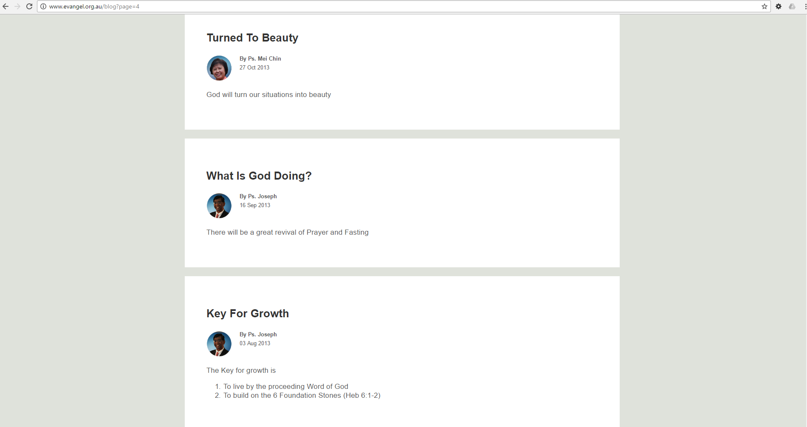

Slide 3
REVIEW
Know Who Our Spiritual Parents Are
Recognise that they are God’s gifts & Appointed by God
Recognise Their Gifting & Their Sphere of Authority
Be Trained & Receive Impartation
Share The Same Assignment
Build, Co-labour, Move Together
Walk In Covenant (JOHN 17)

Slide 4
1. Choose to be connected
Jesus said, “Follow me”
Don’t find excuses but make a decision
We choose to be connected
Attending Sunday Services doesn’t mean we are connected.
Evidences of being connected.
Daniel determined in His heart
Is this your local church?

Slide 5
Luke 14:16-24
¹⁶ Then He said to him, “A certain man gave a great supper and invited many,
¹⁷ and sent his servant at supper time to say to those who were invited, ‘Come, for all things are now ready.’
¹⁸ But they all with one accord began to make excuses. The first said to him, ‘I have bought a piece of ground, and I must go and see it. I ask you to have me excused.

Slide 6
’¹⁹ And another said, ‘I have bought five yoke of oxen, and I am going to test them. I ask you to have me excused.’
²⁰ Still another said, ‘I have married a wife, and therefore I cannot come.’
²¹ So that servant came and reported these things to his master. Then the master of the house, being angry, said to his servant, ‘Go out quickly into the streets and lanes of the city, and bring in here the poor and the maimed and the lame and the blind.’

Slide 7
²² And the servant said, ‘Master, it is done as you commanded, and still there is room.’
²³ Then the master said to the servant, ‘Go out into the highways and hedges, and compel them to come in, that my house may be filled.
²⁴ For I say to you that none of those men who were invited shall taste my supper.’”

Slide 8
2. Lay down our preferences
1 Cor 2: 1-2
And I, brethren, when I came to you, did not come with excellence of speech or of wisdom declaring to you the testimony of God. ² For I determined not to know anything among you except Jesus Christ and Him crucified

Slide 9
Christ must be our centrality
Don’t promote self with our preferences
My ideas are not always the best
Church has to be Christ’s kind of Church
Relevance is not modernisation but by being current with what God is saying NOW
Love vs Discipline

Slide 10
3. Handle Offenses
Luke 17:1-4
¹Then He said to the disciples, “It is impossible that no offenses should come, but woe to him through whom they do come!
² It would be better for him if a millstone were hung around his neck, and he were thrown into the sea, than that he should offend one of these little ones.
³ Take heed to yourselves. If your brother sins against you, rebuke him; and if he repents, forgive him.
⁴ And if he sins against you seven times in a day, and seven times in a day returns to you, saying, ‘I repent,’ you shall forgive him.”

Slide 11
Offenses will cause bitterness
Word will be choked by the cares of this world
Guard our hearts
Offenses not dealt with will cause people to pull back from the church
Offenses and bitterness will create a lot of speculation

Slide 12
Matthew 18:15-17
¹⁵ “Moreover if your brother sins against you, go and tell him his fault between you and him alone. If he hears you, you have gained your brother.
¹⁶ But if he will not hear, take with you one or two more, that ‘by the mouth of two or three witnesses every word may be established.’
¹⁷ And if he refuses to hear them, tell it to the church. But if he refuses even to hear the church, let him be to you like a heathen and a tax collector.

Slide 13
Handle It
Between yourselves
With Two or Three Witnesses
With the Church

Slide 14
4.Pay The Price
We pay the price when we know it is worth and has value
The Church is precious in God’s sight.
It has to do with our Willingness and Attitude.
Resources are now too easy to get and as a result we take it for granted.
It has to do with how we prioritise.

Slide 15
Conclusion
How Do We Know That We Are Connected?
Until The Opportunity Arrives
How we respond to it
See Daniel… He was tested

